Slide 1
Oral History
Interviews
Overview
Content courtesy of Karen Brewster, Oral History Program,
University of Alaska Fairbanks

Slide 2


Know, Want to Know…
Let’s start off by listing what you know about oral histories.
Ask yourself: where have you heard this term before?
Also ask yourself: what do you want to know about it?
Let’s share our thoughts!
Is this
thing on??

Slide 3
What’s It All About?
An oral history is….
A sound recording of a person’s memories.
Also known as a “spoken history”
Shows the past from a personal perspective and often covers aspects of history not in written documents.

Slide 4
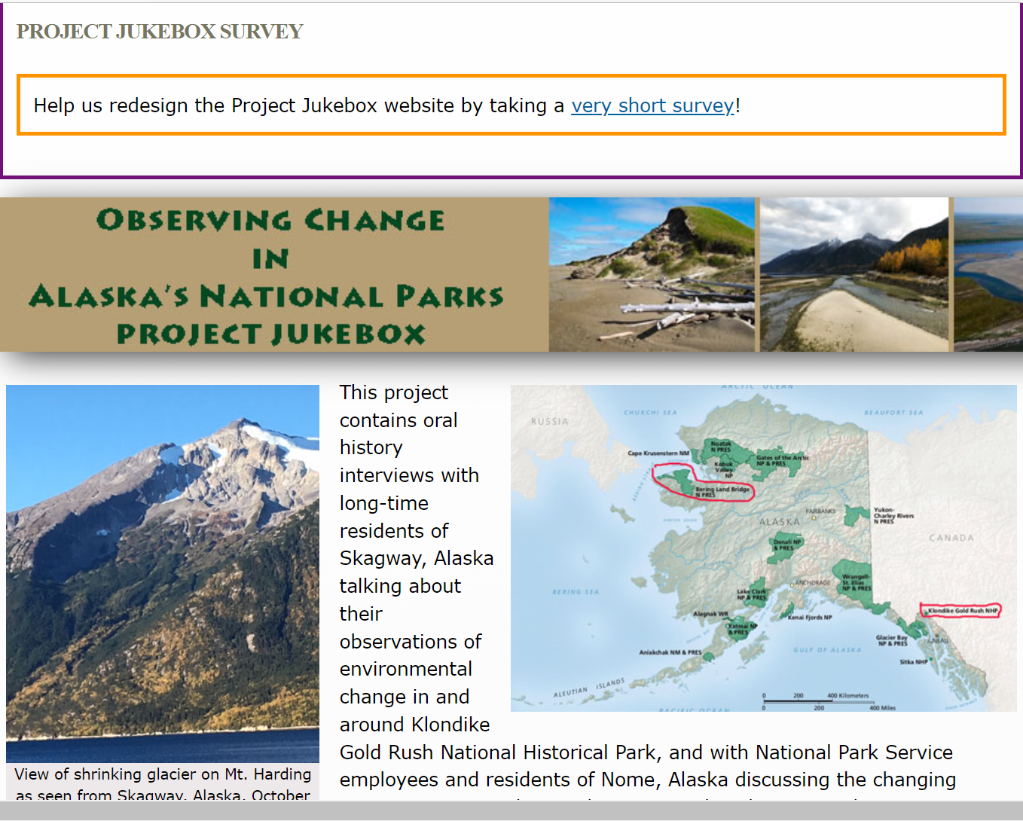
Why is Oral History Important?
Opens new views of the past
Sharing of personal stories creates understanding between cultures and generations
Brings history to life when hearing from someone who lived it

Slide 5
Designing an
Oral History Project
Choose relevant topic
Research topic and themes so you can create your questions
Find people easy to access but knowledgeable in your topic area. These are your interviewees!
Conduct interview
Compile answers for others to access
Notes:
Tell students that they need to inform their selected interviewees about their project and

Slide 6
Preparing for Your Interview
Write your interview questions.
Schedule a time when you and your interviewee can both meet.
Have an audio recorder.

Slide 7
Writing Interview
Questions (1 of 2)
Make sure your questions are:
Brief and to the point
2. Open-ended to encourage more than a “yes” or “no” answer
3. Allow for follow-up questions (outside of your five main questions)
4. Go beyond the surface to dig deeper for more information
5. Respectful and do not pry for inappropriate details.

Slide 8
Writing Interview
Questions (2 of 2)
Base your interview questions on these factors:
1. The purpose of the interview
2. The background of the interviewee. Who are they? Why are you interviewing them? What questions will they be able to answer?
3. Social, economic, ideological, environmental, political, or cultural categories. Cast a wide net while keeping questions specific to your project.

Slide 9
Conducting the Interview (1 of 2)
Dress respectfully.
Be courteous and friendly.
Bring interview checklist (equipment, notepad, questions).
Explain again what you are doing and how their answers will be used (Hint: for your project!)

Slide 10
Conducting the Interview (2 of 2)
Start with a simple question and then move into a question that requires more response.
Ask one question at a time.
Ask open-ended questions – “why, what was that like, describe, tell me about, how did that make you feel, can you explain.” Your role is to inspire the person to talk!
The interview should be no more than an hour long.

Slide 11
Important Tips During Interview (1 of 2)
No value judgments – respect their opinions and beliefs.
Be a good listener.
Do not interrupt or correct.
Make eye contact.
Respond with nods to show you’re listening instead of saying, "Uh huh."

Slide 12
Important Tips During Interview (2 of 2)
Ask the interviewee to repeat something if you do not understand.
Make sure you are taking notes so you can ask follow-up questions or in case the audio recorder fails. And to use when putting together your final project.
At the end, ask if there is anything else they want to share.

Slide 13
After the Interview (1 of 2)
Thank the person for their time.
If the recording is going to be put in an archive, have the narrator sign a release agreement.
Take a photo of the narrator and other things related to the interview if you are making a visual presentation of your project.
Send a thank you note and copy of the recording if they wanted one.

Slide 14
After the Interview (2 of 2)
Download and save your audio recordings as a file to your computer.
To better analyze the recording, consider typing out the interview audio as a transcript. You can also use your notes.
Think of the person’s answers like data. Analyze and synthesize your data in your project.

Slide 15
Remember…
You want your interviewee to understand the purpose of this interview!
You want your interviewee to share their honest perspective.
You want to learn as much as possible from your interviewee.

